Slide 1
Project story boards

Slide 2
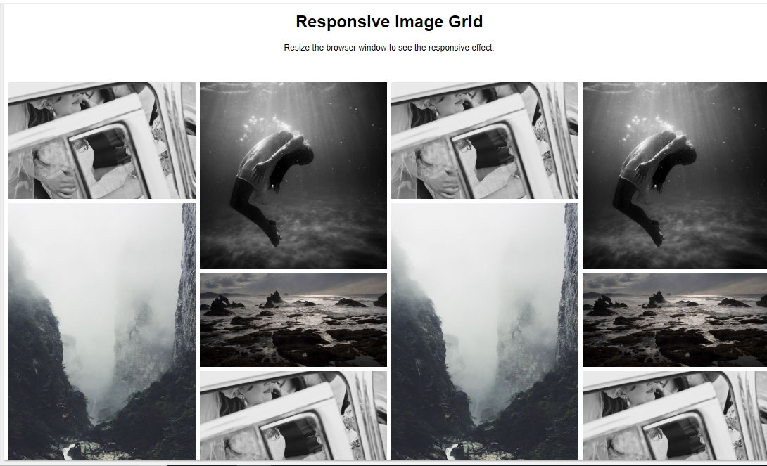
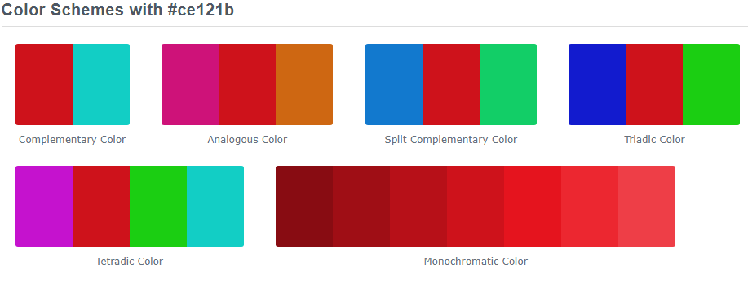
Grid
Filtered pictures
Product description on hover
GratisMundi

